Slide 1
Floquet Coordinates, Resonance, and Couplings
Eric Prebys, FNAL

Slide 2
Non-linear Perturbations
In our earlier lectures, we found the general equations of motion
We initially considered only the linear fields, but now we will bundle all additional terms into ΔB
non-linear plus linear field errors
We see that if we keep the lowest order term in ΔB, we have
This part gave us the Hill’s equation

Slide 3
Floquet Transformation
Evaluating these perturbed equations can be very complicated, so we will seek a transformation which will simplify things
Our general equation of Motion is
This looks quite a bit like a harmonic oscillator, so not surprisingly there is a transformation which looks exactly like harmonic oscillations
After a couple pages of messy math, we find that the general equation of motion is
Harmonic Oscillator
Driving Term

Slide 4
Understanding Floquet Coordinates
In the absence of nonlinear terms, our equation of motion is simply that of a harmonic oscillator
and we write down the solution
Thus, motion is a circle in the plane
Using our standard formalism, we can express this as
A common mistake is to view φ as the phase angle of the oscillation.
νϕ the phase angle of the oscillation
φ advances by 2π in one revolution, so it’s related (but NOT equal to!) the angle around the ring.
unnormalized!

Slide 5
Perturbations
In general, resonant growth will occur if the perturbation has a component at the same frequency as the unperturbed oscillation; that is if
We will expand our magnetic errors at one point in φ as
But in general, b_{n} is a function of ϕ, as is β, so we bundle all the dependence into harmonics of ϕ
So the equation associated with the n^{th} driving term becomes
Note:
Remember!
ξ,β, and b_{n} are all functions of (only) ϕ

Slide 6
Calculating Driving Terms
We can Fourier transform to calculate the C_{m,n} coefficients based on the measured fields
But we generally know things as functions of s, so we use to get
Where (for a change) we have explicitly shown the s dependent terms.
We’re going to assume small perturbations, so we can approximate β with the solution to the homogeneous equation

Slide 7
Example
Plugging this in, we can write the nth driving term as
We see that a resonance will occur whenever
Since m and k can have either sign, we can cover all possible combinations by writing
Reminder
n= power of multipole expansion (quad=1, sextupole=2, octupole=2, etc)
m= Fourier component of anomalous magnetic component when integrated around the ring.

Slide 8
Types of Resonances
Magnet Type | n | k | Order |1-k| | Resonant tunes ν=m/(1-k) | Fractional Tune at Instability
Dipole | 0 | 0 | 1 | m | 0,1
Quadrupole | 1 | 1 | 0 | none (tune shift) | -
 | 1 | -1 | 2 | m/2 | 0,1/2,1
Sextupole | 2 | 2 | 1 | m | 0,1
 | 2 | 0 | 1 | m | 0,1
 | 2 | -2 | 3 | m/3 | 0,1/3,2/3,1
Octupole | 3 | 3 | 2 | m/2 | 0,1/2,1
 | 3 | 1 | 0 | None | -
 | 3 | -1 | 2 | m/2 | 0,1/2,1
 | 3 | -3 | 4 | m/4 | 0,1/4,1/2,3/4,1

Slide 9
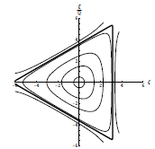
Example: Sextupole (Third Order Resonance)
The third order resonance will occur at tunes near m/3.
The strength of the resonance will be given by
It will perturb the stable region of phase space into a triangle
Sextupole term
Convert back to ordinary phase angle
Relative size of
Terms determine
Orientation in phase space

Slide 10
Strength of Resonance
The size of the stable region in phase space with shrink with increased driving strength or by moving the tune closer to m/3.

Slide 11
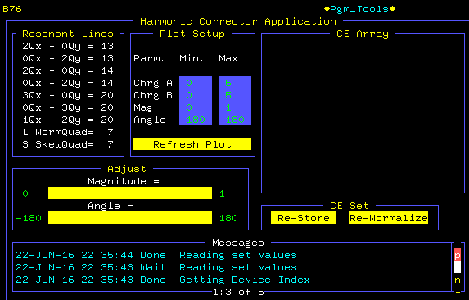
Use of Driving Terms
We see that in general, magnetic imperfections drive specific resonances based on the harmonic content of individual multipole moments.
This means that unwanted resonances can be canceled out by installing multipoles to drive that specific harmonic term.
Example: Booster harmonic corrector page
Third order resonances near ν=6 2/3
Control magnitude and phase (A vs B terms)

Slide 12
Application of Resonance
If we increase the driving term (or move the tune closer to m/3), then the area of the triangle will shrink, and particles which were inside the separatrix will now find themselves outside
These will stream out along the asymptotes at the corners.
These particles can be intercepted by an extraction channel
➔Slow extraction (ms to many seconds)
Very common technique
Unstable beam motion in N(order) turns
Extraction Field
Extracted beam
Lost beam
Septum

Slide 13
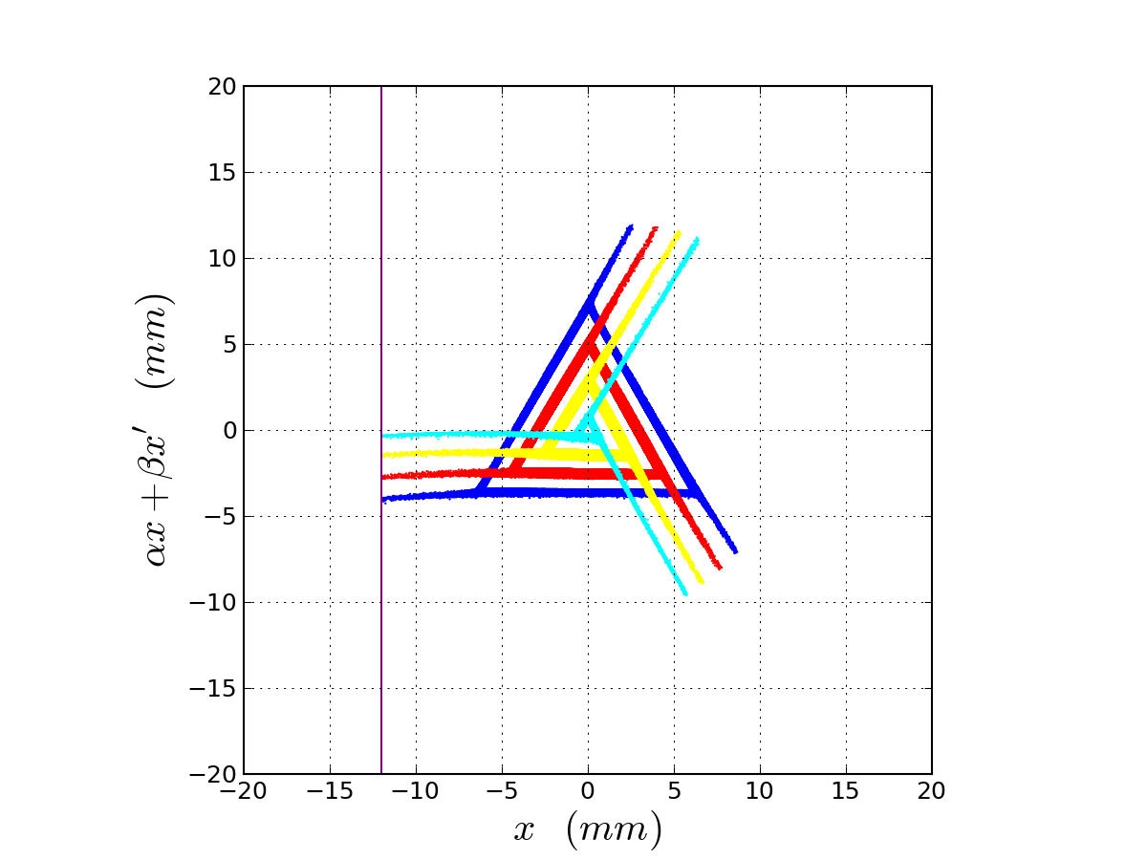

Example: Mu2e Experiment 8 GeV Extraction
Use sextupoles to drive 3rd integer resonance
Moving tune closer to m/3 will reduce stable phase space, causing beam to be removed at a steady rate
Electrostatic septum at 80 kV/1cm deflects beam into a downstream Lambertson magnet

Slide 14
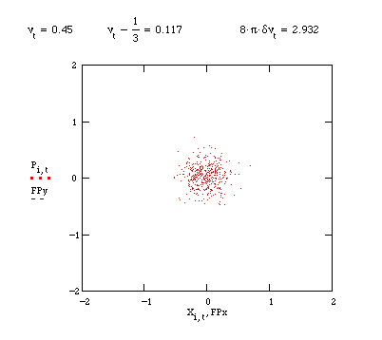
Simulation of Third Integer Extraction*
*M. Syphers

Slide 15
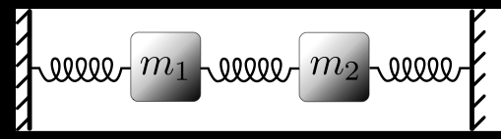
Coupled Harmonic Oscillators
Equations of motion
Define uncoupled frequencies:
Try a solution of he form:
Multiply the top by the bottom:

Slide 16
➔
Weak Coupling
Degenerate Case:
Resonance splitting

Slide 17
Formalism
General coupled equation
General solution
➔
i.e. ω² are the eigenvalues of M and (a,b) are the linear combinations of x and y which undergo simple harmonic motion.

Slide 18
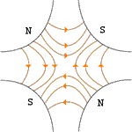
Application to Accelerators
Introduce skew-quadrupole term
Planes coupled
x and y motion not
independent
General Transfer Matrix
Normal Quad

Slide 19
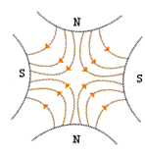
Skew quad
So the transfer matrix for a skew quad would be:
For a normal quad rotated by ϕ it would be

Slide 20
Coupling in Floquet Coordinates
In Floquet Coordinates
Dimensionless coupling

Slide 21
Coupled Tunes
If there’s no coupling, then
If there’s coupling, then there will always be a tune split

Slide 22
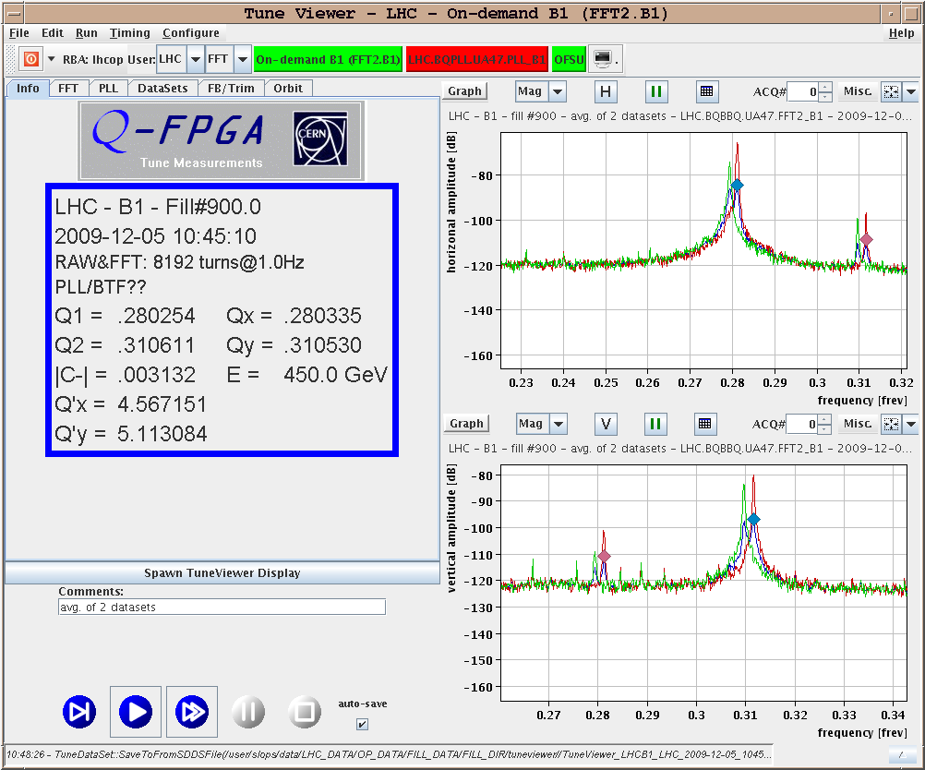
Example: Tune Coupling in LHC

Slide 23
Example: NSLS-II 3 GeV Electron Ring (BNL)
Minimum tune separation before and after correction.

Slide 24
Example Problem (from 2012 final)
A 10 GeV proton synchrotron is found to have a minimum tune separation of .02. If this is due to coupling, determine the dimensionless coupling strength κ
If a skew quadrupole is located at a location where bx=50m and by=20, what integrated skew quadrupole field would be required to generate this tune splitting?

Slide 25
(cont’d)
By what angle would a 1 m long 1 T/m normal quad have to be rotated to produce this coupling?

Slide 26
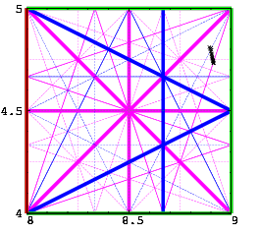
Coupling and Resonances
Although we won’t derive it in detail, it’s clear that if motion is coupled, we can analyze the system in terms of the normal coordinates, and repeat the analysis in the last chapter. In this case, the normal tunes will be linear combinations of the tunes in the two planes, and so the general condition for resonance becomes.
This appears as a set of crossing
lines in the nx,ny “tune space”.
The width of individual lines
depends on the details of the
machine, and one tries to pick
a “working point” to avoid
the strongest resonances.

